Slide 1
Single Variable Visualization
At this time, we will focus in on a single variable, i.e., for each particular trait we have n observations on this trait, namely x_{1j}, x_{2j}, …, x_{nj}. With what tools can we analyze this set of values?
Data Frame:
Variables
Units
j ^{th} variable
Our first set of tools include pictorial and frequency methods from Descriptive Statistics.

Slide 2
The Cars93 Data Frame
The Cars93 data frame (in the MASS package) contains information on 93 cars sold in the U.S. in the year 1993. It has 93 rows and 27 columns. Additional information is available using ?Cars93 or help(Cars93)
The command head displays the first few lines (the default is 6) of an object in R.
> head(Cars93)
Manufacturer Model Type Min.Price Price Max.Price MPG.city MPG.highway AirBags DriveTrain
1 Acura Integra Small 12.9 15.9 18.8 25 31 None Front
2 Acura Legend Midsize 29.2 33.9 38.7 18 25 Driver & Passenger Front
3 Audi 90 Compact 25.9 29.1 32.3 20 26 Driver only Front
4 Audi 100 Midsize 30.8 37.7 44.6 19 26 Driver & Passenger Front
5 BMW 535i Midsize 23.7 30.0 36.2 22 30 Driver only Rear
6 Buick Century Midsize 14.2 15.7 17.3 22 31 Driver only Front
Cylinders EngineSize Horsepower RPM Rev.per.mile Man.trans.avail Fuel.tank.capacity Passengers Length
1 4 1.8 140 6300 2890 Yes 13.2 5 177
2 6 3.2 200 5500 2335 Yes 18.0 5 195
3 6 2.8 172 5500 2280 Yes 16.9 5 180
4 6 2.8 172 5500 2535 Yes 21.1 6 193
5 4 3.5 208 5700 2545 Yes 21.1 4 186
6 4 2.2 110 5200 2565 No 16.4 6 189
Wheelbase Width Turn.circle Rear.seat.room Luggage.room Weight Origin Make
1 102 68 37 26.5 11 2705 non-USA Acura Integra
2 115 71 38 30.0 15 3560 non-USA Acura Legend
3 102 67 37 28.0 14 3375 non-USA Audi 90
4 106 70 37 31.0 17 3405 non-USA Audi 100
5 109 69 39 27.0 13 3640 non-USA BMW 535i
6 105 69 41 28.0 16 2880 USA Buick Century

Slide 3
Distribution of a Variable
The distribution of a variable provides the possible values that a variable can take on and how often (frequently) these possible values occur. The distribution of a variable shows the pattern of variation of the variable.
The distribution of a variable can be summarized graphically, numerically, or with a model.

Slide 4
Displaying Distributions Categorical Variables
Categorical variables are usually not measured on a numerical scale. Typically, the frequency or percentage of observations in each category is displayed.
Definition: A frequency of a category is the number of times it occurs in the data set.
Definition: A frequency distribution is a table that presents the frequency for each category.
Example: The data frame Cars93 contains data from 93 cars on sale in the USA in 1993. We can use the table function to find the frequency distribution for the standard airbag option.
> table(Cars93$AirBags)
Driver & Passenger Driver only None
16 43 34

Slide 5
Displaying Distributions Categorical Variables
Definition: The relative frequency of a category is the frequency of the category divided by the sum of all the frequencies.
Definition: A relative frequency distribution is a table that presents the relative frequency of each category
-typically more useful
Example: We can use the table function to display the relative frequency for the standard airbag option in the Cars93 dataset.
> table(Cars93$AirBags)/nrow(Cars93)
Driver & Passenger Driver only None
0.1720430 0.4623656 0.3655914
> round(table(Cars93$AirBags)/nrow(Cars93),3)
Driver & Passenger Driver only None
0.172 0.462 0.366

Slide 6
Displaying Distributions Categorical Variables
Definition: The relative frequency of a category is the frequency of the category divided by the sum of all the frequencies.
Definition: A relative frequency distribution is a table that presents the relative frequency of each category
-typically more useful
Example: We can use the table function to display the relative frequency for the standard airbag option in the Cars93 dataset.
> table(Cars93$AirBags)/nrow(Cars93)
Driver & Passenger Driver only None
0.1720430 0.4623656 0.3655914
> round(table(Cars93$AirBags)/nrow(Cars93),3)
Driver & Passenger Driver only None
0.172 0.462 0.366

Slide 7
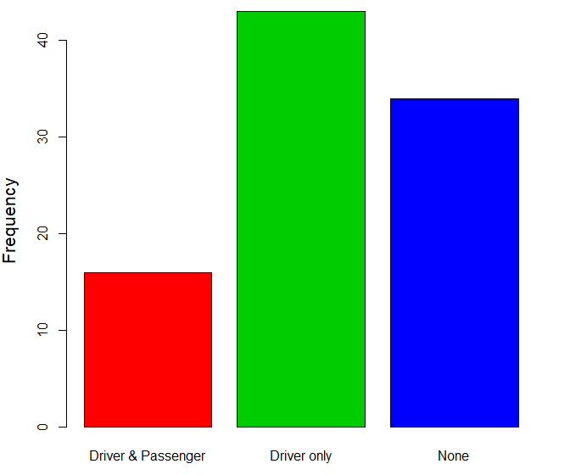
Bar Graphs
A bar graph is a graphical representation of a frequency distribution.
One bar is displayed for each category, and the height of each bar is the frequency (count) or relative frequency (proportion) in each category.
The width of the bars has no meaning.
> barplot(table(Cars93$AirBags),ylab="Frequency",cex.lab=1.3,col=c(2,3,4))
> barplot(table(Cars93$AirBags)/nrow(Cars93),ylab="Relative Frequency",
+ cex.lab=1.3,cex.names=1.2,col=c(2,3,4))

Slide 8
A Note on Colors
You will often want to add color to a graphic (lines, plotting characters, fill, …) and R has a large variety of color possibilities. As is often the case in R, there are multiple ways to specify colors.
The available built-in color names can be accessed with the colors function. Here are the first 20 (of 657)
> colors()[1:20]
[1] "white" "aliceblue" "antiquewhite" "antiquewhite1" "antiquewhite2"
[6] "antiquewhite3" "antiquewhite4" "aquamarine" "aquamarine1" "aquamarine2"
[11] "aquamarine3" "aquamarine4" "azure" "azure1" "azure2"
[16] "azure3" "azure4" "beige" "bisque" "bisque1"
The color palette tells R which color name is referred to by a specific integer. It can be viewed using the palette function.
> palette()
[1] "black" "red" "green3" "blue" "cyan" "magenta" "yellow" "gray"
This shows that in the current palette (the default) 1 indicates black, 2 gives red, 3 gives green3, 4 gives blue, etc.

Slide 9
A Note on Colors
You can also set the palette with the palette command.
> palette(c("red2","orchid1","yellow4","tomato2"))
> palette()
[1] "red2" "orchid1" "yellow4" "tomato2"
The color palette now assigns 1 to red2, 2 to orchid1, 3 to yellow4, etc. We can restore the default at any time using
> palette(“default”)
> palette()
[1] "black" "red" "green3" "blue" "cyan" "magenta" "yellow" "gray"
When setting the col parameter, either use the color names (with quotes around them) or first set the palette and then use the mapped integers.
Additional colors in R can be created using primitives rgb, hsv, and hcl or the derived rainbow, and heat.color.

Slide 10
Example
We can obtain the two-way frequency table of Airbags by Origin using:
> table(Cars93$AirBags,Cars93$Origin)
USA non-USA
Driver & Passenger 9 7
Driver only 23 20
None 16 18
> barplot(table(Cars93$AirBags,Cars93$Origin),col=c(2,3,4),beside=T,
+ ylim=c(0,30), cex.axis=1.2)
> legend(x=5,y=30,title="Airbags",legend=sort(unique(Cars93$AirBags)),
+ fill=c(2,3,4))
The script above provides the figure to the right depicting the AirBags variable as a function of the Origin variable.

Slide 11
Example
We can obtain the two-way frequency table of Airbags by Origin using:
> table(Cars93$AirBags,Cars93$Origin)
USA non-USA
Driver & Passenger 9 7
Driver only 23 20
None 16 18
> barplot(table(Cars93$AirBags,Cars93$Origin),col=c(2,3,4),beside=T,
+ ylim=c(0,30), cex.axis=1.2)
> legend(x=5,y=30,title="Airbags",legend=sort(unique(Cars93$AirBags)),
+ fill=c(2,3,4))
The script above provides the figure to the right depicting the AirBags variable as a function of the Origin variable.

Slide 12
Pie Charts
A pie chart is a graphical method for displaying the distribution of a qualitative variable.
The circle or pie represents the whole (all the units). The pie is divided into slices, one for each category of the qualitative variable.
> pie(table(Cars93$AirBags),main="Standard Air Bags",col=c(2,3,4),cex=1.3)
Now, your turn! Visualize another variable in Cars93 by creating a bar graph and a pie chart.

Slide 13
Pie Charts
A pie chart is a graphical method for displaying the distribution of a qualitative variable.
The circle or pie represents the whole (all the units). The pie is divided into slices, one for each category of the qualitative variable.
> pie(table(Cars93$AirBags),main="Standard Air Bags",col=c(2,3,4),cex=1.3)
Now, your turn! Visualize another variable in Cars93 by creating a bar graph and a pie chart.

Slide 14

*Makes chart in R instead of Excel
I’m something of data scientist myself

Slide 15
Displaying Distributions: Quantitative Variables
When a variable is quantitative, there are no natural categories.
Example: Consider the data
giving the particulate emissions for 65 vehicles in grams per gallon.
The maximum value is 6.64, while the minimum value is 0.25.
How are the values distributed?
1.5 | 0.87 | 1.12 | 1.25 | 3.46 | 1.11 | 1.12 | 0.88 | 1.29 | 0.94 | 0.64 | 1.31 | 2.49
1.48 | 1.06 | 1.11 | 2.15 | 0.86 | 1.81 | 1.47 | 1.24 | 1.63 | 2.14 | 6.64 | 4.04 | 2.48
1.4 | 1.37 | 1.81 | 1.14 | 1.63 | 3.67 | 0.55 | 2.67 | 2.63 | 3.03 | 1.23 | 1.04 | 1.63
3.12 | 2.37 | 2.12 | 2.68 | 1.17 | 3.34 | 3.79 | 1.28 | 2.1 | 6.55 | 1.18 | 3.06 | 0.48
0.25 | 0.53 | 3.36 | 3.47 | 2.74 | 1.88 | 5.94 | 4.24 | 3.52 | 3.59 | 3.1 | 3.33 | 4.5

Slide 16
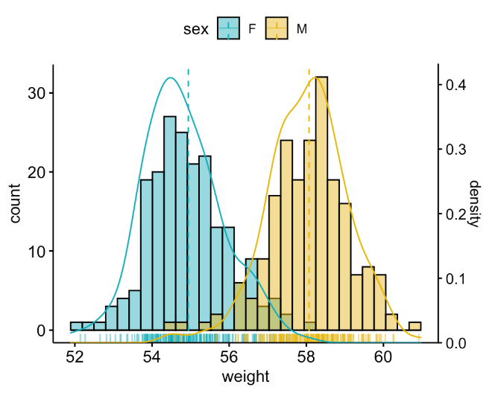
Graphical Methods: Quantitative Variables
Graphical Methods often convey important information about the structure of the data set including:
Overall shape of the data set (e.g., symmetric or skewed)
Presence of gaps in the data set
Number and location of peaks (modes) in the data set
Presence of outliers
Identification of a representative value and the extent of spread
One of the most widely used graphic to visualize numerical data:
Histogram

Slide 17

Displaying Distributions: Histogram

Slide 18

Have you tried making a histogram yet?

Slide 19
Displaying Distributions: Histogram
When a variable is quantitative, there are no natural categories. One strategy is to divide the range of the data into classes that cover all the values that are observed.
Example: Recall the data
giving the particulate emissions for 65 vehicles in grams per gallon.
The maximum value is 6.64, while the minimum value is 0.25.
How are the values distributed?
1.5 | 0.87 | 1.12 | 1.25 | 3.46 | 1.11 | 1.12 | 0.88 | 1.29 | 0.94 | 0.64 | 1.31 | 2.49
1.48 | 1.06 | 1.11 | 2.15 | 0.86 | 1.81 | 1.47 | 1.24 | 1.63 | 2.14 | 6.64 | 4.04 | 2.48
1.4 | 1.37 | 1.81 | 1.14 | 1.63 | 3.67 | 0.55 | 2.67 | 2.63 | 3.03 | 1.23 | 1.04 | 1.63
3.12 | 2.37 | 2.12 | 2.68 | 1.17 | 3.34 | 3.79 | 1.28 | 2.1 | 6.55 | 1.18 | 3.06 | 0.48
0.25 | 0.53 | 3.36 | 3.47 | 2.74 | 1.88 | 5.94 | 4.24 | 3.52 | 3.59 | 3.1 | 3.33 | 4.5

Slide 20
Choosing the Classes
Requirements for Choosing Classes
Every observation must fall into one of the classes
The classes must not overlap
Classes of equal width
There must be no gaps between classes, even if there are no observations in a class, it is included in the frequency distribution
Relative Frequency Distribution of Particulate Data
Class | Frequency | Relative Frequency
0.00-0.99 [0, 1) | 9 | 0.138
1.00-1.99 [1, 2) | 26 | 0.400
2.00-2.99 [2, 3) | 11 | 0.169
3.00-3.99 [3, 4) | 13 | 0.200
4.00-4.99 [4, 5) | 3 | 0.046
5.00-5.99 [5, 6) | 1 | 0.015
6.00-6.99 [6, 7) | 2 | 0.031

Slide 21
Histogram of Particulate Data
Class | Frequency | Relative Frequency
0.00-0.99 [0, 1) | 9 | 0.138
1.00-1.99 [1, 2) | 26 | 0.400
2.00-2.99 [2, 3) | 11 | 0.169
3.00-3.99 [3, 4) | 13 | 0.200
4.00-4.99 [4, 5) | 3 | 0.046
5.00-5.99 [5, 6) | 1 | 0.015
6.00-6.99 [6, 7) | 2 | 0.031
> hist(Particulate,cex.lab=1.2,cex.axis=1.2,col="lightgray",
+ xlab="Particulate (g/gal)")

Slide 22
Model Talk Eps 4 (?)
Why visualization is important

Slide 23
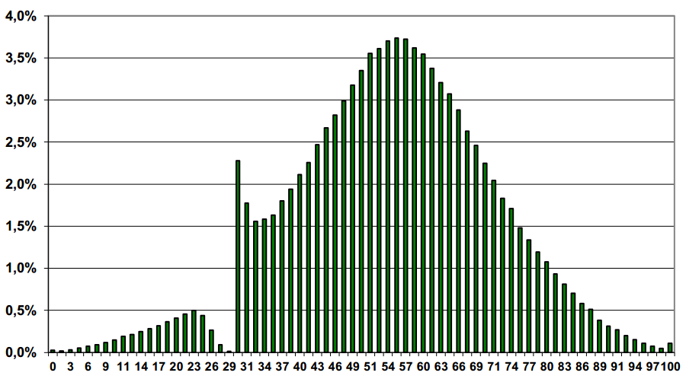

Slide 24


Slide 25
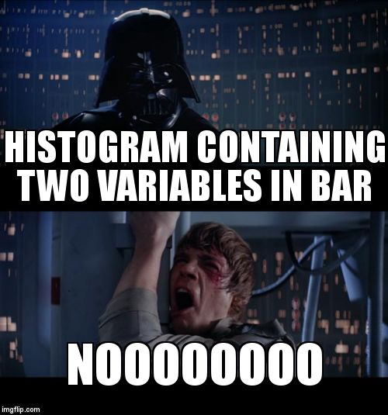
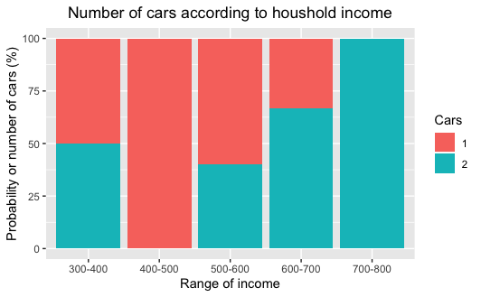

Slide 26
GRAPH CRIME!

Slide 27

Selecting the Number of Classes?
A good rule of thumb is number of classes ≈

Slide 28
Histogram of Particulate Data
Setting the classes using breaks
> hist(Particulate,cex.lab=1.2,cex.axis=1.2,col="lightgray",breaks=seq(0,7,.5),
+ xlab="Particulate (g/gal)")
> box()
Above, the command seq(0,7,.5)creates the vector with the sequence
(0, 0.5, 1, 1.5, 2, 2.5, 3, 3.5, 4, 4.5, 5, 5.5, 6, 6.5, 7)
which is used for the endpoints of the histogram classes.

Slide 29
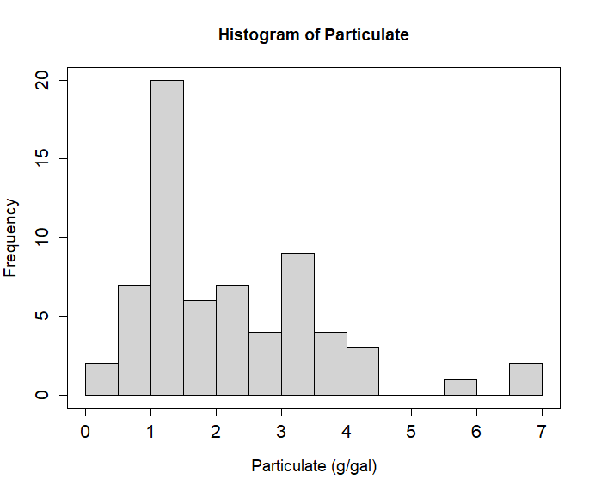
Histogram of Particulate Data
Setting the classes using breaks
> hist(Particulate,breaks=14,col="lightgray",xlab="Particulate (g/gal)",
+ cex.lab=1.2,cex.axis=1.3)
> box()
Above, the command setting breaks to 14 tells R we would like 14 classes.
Note: when an integer is used in the breaks argument, the number is taken as a suggestion only, and the breakpoints will be set to “pretty” values.

Slide 30
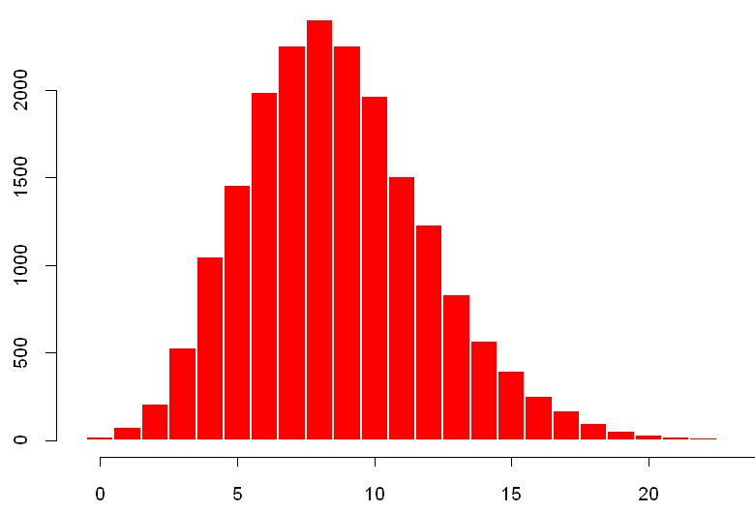

Histograms for Discrete Data
When the data are discrete, we can construct a frequency distribution in which each possible value of the variable forms a class.
Each rectangle represents one value of the variable
Rectangles are just wide enough to touch
This tells you on the spot that what you have is in fact a barplot!!
You can create such graphs as barplots in R.
Example: Below are the frequency and relative frequency histograms for the number of hits in a 9-inning game for 19,383 baseball games.
Frequency
Relative Frequency
Hits
Hits

Slide 31
Practice time! Go to Cars93 dataset and
1. Pick a continuous numerical variable, create a histogram.
2. Pick a discrete numerical variable, create a barplot where each value forms its own category.

Slide 32
Shapes of Distributions
A histogram is symmetric if its right half is a mirror image of its left half.
− Rarely perfectly symmetric, many are
approximately symmetric
A histogram is skewed to the right if it has a long right-hand tail.
− Also called positively skewed.
A histogram is skewed to the left if it has a long left-hand tail.
− Also called negatively skewed.

Slide 33
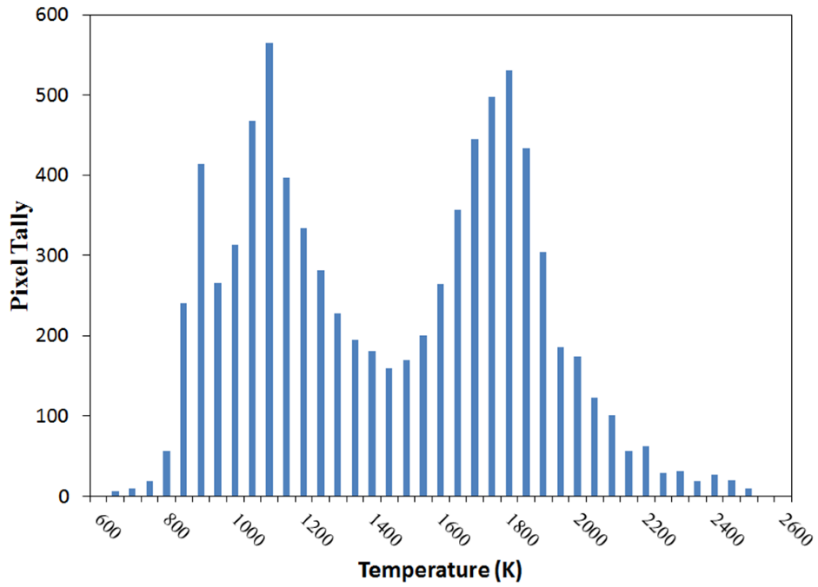
Modes
A peak, or high point, of a histogram is referred to as a mode.
− A histogram is unimodal if it has only one mode and
bimodal if it has two distinct modes.
− A histogram can have three or more modes, but this is
rarely seen in practice
− Modes often represent different populations within the group
Elvidge CD, Zhizhin M, Baugh K, Hsu F-C, Ghosh T. Methods for Global Survey of Natural Gas Flaring from Visible Infrared Imaging Radiometer Suite Data. Energies. 2016; 9(1):14.

Slide 34
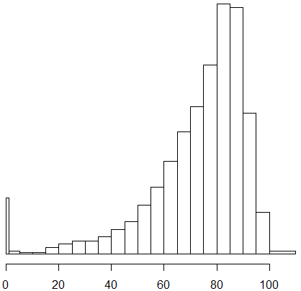
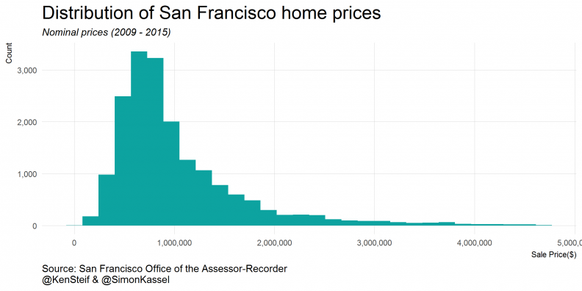
Shapes of Distributions
What shape would you expect for the following distributions?
Age at death of American citizens
Home prices in a metropolitan area?

Slide 35
How about numerical summaries? Measures of Center
Definition: Measures of center are numerical values that attempt to report in some sense the “middle” of a set of data.
Notation:
Σ denotes the addition (or sum) of a set of values
x is the variable used to represent individual data values
n represents the number of data values in a sample
N represents the number of data values in a population
A list of n numbers is denoted x₁, x₂, …, x_{n}
The sum of these numbers is Σx_{i} = x₁ + x₂ + … + x_{n}

Slide 36
Measures of Center
Suppose we want to add up n numbers
We write this compactly as
upper limit of the summation
means sum
terms
lower limit of the summation
index of summation
Find
Find

Slide 37
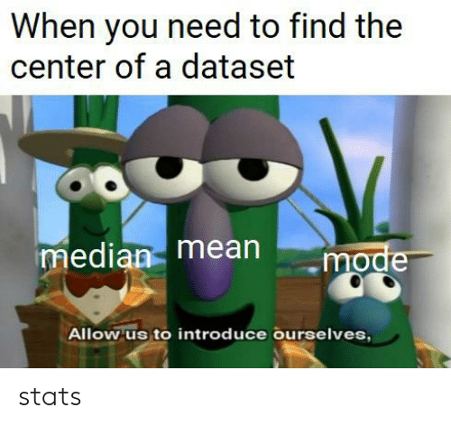

Slide 38
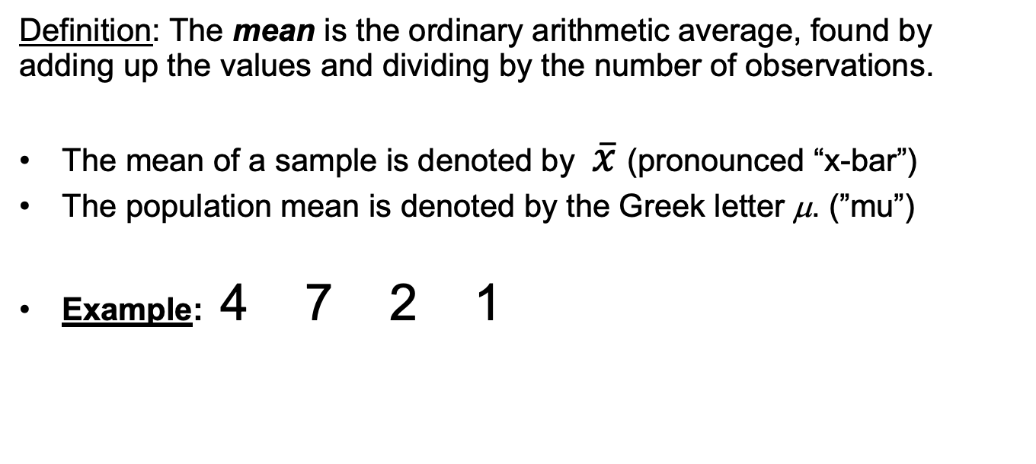
The Mean
Definition: The mean is the ordinary arithmetic average, found by adding up the values and dividing by the number of observations.
The mean of a sample is denoted by $\overline{x}$(pronounced “x-bar”)
The population mean is denoted by the Greek letter μ. (”mu”)
Example: 4 7 2 1
1
3
5
7

Slide 39
Is the Mean Always the Center?
Can you think of a situation where the mean is not as “informative”?

Slide 40
Is the Mean Always the Center?
1
2
3
4
1
2
3
8
Mean = 2.5
Mean = 3.17
1
2
3
25
Mean = 6
The mean shifts towards an extreme observation.
If a distribution appears skewed, we may wish to also report a more resistant measure of center.
Note: The mean is not necessarily a “typical” value for the data set.

Slide 41
The Median
Definition: The median is the “middle” observation (once the values are arranged in order)
To calculate the median M, sort all observations from smallest to largest:
If n is odd, M is the middle number in the list
If n is even, M is the mean of the middle two numbers in the list
The symbol is also commonly used for the median.
The median is the 50th percentile.

Slide 42
Median Example
Odd number: 6.72 3.46 3.60 6.44 26.70
First arrange the values in order, then pick the middle value
3.46 3.60 6.44 6.72 26.70
Even number: 6.72 3.46 3.60 6.44
First arrange the values in order, then compute the mean of the two middle values
3.46 3.60 6.44 6.72
M

Slide 43
Median is Resistant
Definition: A statistic is resistant if its value is not affected much by extreme values (in either direction) in the data set.
Recall the median of the following data set:
3.46 3.60 6.44 6.72 26.70
Suppose the last number was incorrectly recorded as 2670. Would the median change?
The median would stay the same.
M
The median is resistant, but the mean is not.

Slide 44
The Mode
Definition: The mode of a data set is the value that occurs most frequently.
When two or more values occur with the same frequency, each one is a mode.
If no value appears more than once, we say the data set has no mode
Examples:
{ 0, 0, 0, 0, 1, 1, 2, 2, 3, 4 }
{ 0, 0, 0, 1, 1, 2, 2, 2, 3, 4 }

Slide 45
Mode Continued
The mode can be computed for qualitative data.
Example: Suppose that eye color was categorized as follows:
Brown, Blue, or Green
0.60
Relative Frequency
0.20
Brown
Blue
Green

Slide 46
Practice time! Go to majors dataset posted in Github and
1. Make a barplot showing the different majors in our Data 180 class.
2. Report the mode.
Hints:
Remember, you can read a csv file in R directly from Github by clicking on “Raw” and using that link when calling read.csv()
Use names=df$Major option when using barplot() where df is a dataframe object

Slide 47
Variance and Standard Deviation
Most commonly used numeric measures of variability.
Both measure how far away data points are, on average, from their mean.
Consider waiting times in minutes for the Carlisle brach of M&T Bank:
2, 3, 5, 7, 8
Definition: The sample variance, denoted by s², is computed as follows:
Definition: The sample standard deviation, denoted by s, is the square root of the sample variance:

Slide 48
Relationships of Measures of Center
Mode = Mean = Median
Symmetric & Unimodal
Mean
Mode
Mode
Mean
Median
Median
Left Skewed
Right Skewed

Slide 49
Examples from the Cars93 Data Frame
Manufacturer Model Type Min.Price Price Max.Price MPG.city MPG.highway AirBags
1 Acura Integra Small 12.9 15.9 18.8 25 31 None
2 Acura Legend Midsize 29.2 33.9 38.7 18 25 Driver & Passenger
3 Audi 90 Compact 25.9 29.1 32.3 20 26 Driver only
4 Audi 100 Midsize 30.8 37.7 44.6 19 26 Driver & Passenger
5 BMW 535i Midsize 23.7 30.0 36.2 22 30 Driver only
6 Buick Century Midsize 14.2 15.7 17.3 22 31 Driver only
Get the mean, median, sd of MPG.city
> mean()
> median()
> sd()
Mode of # of cylinders? # of airbags?
> table()

Slide 50
What if you want to visualize more than one variable, aka relationships?
Given paired data, we may wish to determine if there is a relationship between the two variables and, if so, identify what the relationship is.
Does blood pressure predict life expectancy?
Do SAT scores predict college performance?
If such a relationship exists, perhaps we can find an equation describing it, then we could use the equation to make predictions, aka regression. (more on this later in the course!)

Slide 51
Visualizing Bivariate Data with a Scatterplot
Size (Sq. ft.) | 2521 | 2555 | 2735 | 2846 | 3028 | 3049 | 3198 | 3198
Selling Price ($1000s) | 400 | 426 | 428 | 435 | 469 | 475 | 488 | 455
The table gives the size in square feet and the selling price in 1000s of dollars, for a sample of houses in a suburban Denver neighborhood. Here, each house is a unit and contributes an ordered pair of numbers: (Size, Selling Price) NOTE: Correlation does not mean causation!!

Slide 52
How to create a scatterplot in R?

Slide 53
Examples from the Cars93 Data Frame
> plot(MPG.highway~Horsepower,data=Cars93,pch=16,cex.lab=1.2,cex.axis=1.2)
> plot(MPG.highway~MPG.city,data=Cars93,pch=16,cex.lab=1.2,cex.axis=1.2)

Slide 54
Examples from the Cars93 Data Frame
Or,
> plot(Cars93$Horsepower, Cars93$MPG.highway,pch=16,cex.lab=1.2,cex.axis=1.2)
> plot(Cars93$MPG.city, Cars93$MPG.highway,pch=16,cex.lab=1.2,cex.axis=1.2)

Slide 55
Practice time! Go to Cars93 dataset and
1. Pick two continuous numerical variables, create a scatterplot.
2. Report the relationship between the two variables you chose.

Slide 56

ggplot?
R built-in functions for plots
ggplot

